Slide 1
Understanding Solid Edge Type Libraries
Greg Chasteen, Technical Account Manager, Siemens PLM Software

Slide 2
Agenda
Why is automation necessary?
How to Add References?
Understand various Type Libraries available in Solid Edge. Detailed explanation on usage of each type library
Create Your Code to Customize Solid Edge

Slide 3
Necessity of Automation
The complexity of CAD automation can vary from a simple template to a full application, covering simple automation of repetitive tasks to complex optimizations. CAD Automation can provide benefits throughout the entire development lifecycle of a product. These tools offer a number of benefits ranging from increased throughput, enforced common design methods and consistency, and improved quality. By leveraging corporate best practices and lessons learned, CAD Automation provides the right knowledge to the engineer when they need it allowing for first time quality! It has other benefits such as
Knowledge Based Manufacturing
Risk Reduction
Cost and availability of skilled workers
Productivity Benefits
Ease of use and reliability
Better faster service
Rapid ROI and lifetime cost

Slide 4
Solid Edge Core Type Libraries
The Solid Edge core COM type libraries are the APIs that are available to automate the Solid Edge application.
These APIs can be used by any programming or scripting language that supports COM.
You can find these type libraries in the installation path of Solid Edge under the “Program” folder.
For example: “%PROGRAMFILES%\Solid Edge VXX\Program”.
Name | Description | Type Library
SolidEdgeFramework | Solid Edge Framework Type Library | framewrk.tlb
SolidEdgeFrameworkSupport | Solid Edge FrameworkSupport Type Library | fwksupp.tlb
SolidEdgePart | Solid Edge Part Type Library | part.tlb
SolidEdgeGeometry | Solid Edge Geometry Type Library | geometry.tlb
SolidEdgeAssembly | Solid Edge Assembly Type Library | assembly.tlb
SolidEdgeAssemblySync | Solid Edge Assembly Synchronous Type Library | assemblysync.tlb
SolidEdgeDraft | Solid Edge Draft Type Library | draft.tlb
SolidEdgeConstants | Solid Edge Constants Type Library | constant.tlb
SEInstallDataLib | Solid Edge Install Data Library | SEInstallData.dll
SolidEdgeFileProperties | Solid Edge File Properties Object Library | PropAuto.dll
RevisionManager | Solid Edge Revision Manager Object Library | RevMgr.tlb

Slide 5
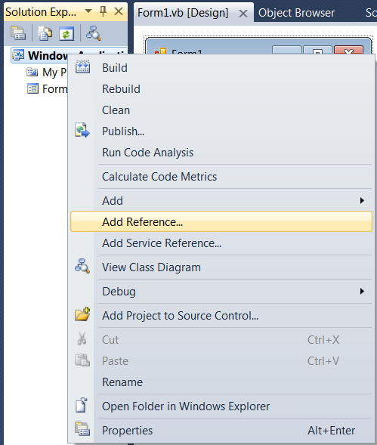
How to add references?
Before you can start working with the Solid Edge API, you'll need to add a reference to the type libraries that you'll be using.
Open the Solution that you had created in previous session.
You can begin by selecting Project -> Add Reference from the main menu in Visual Studio .NET.

Slide 6
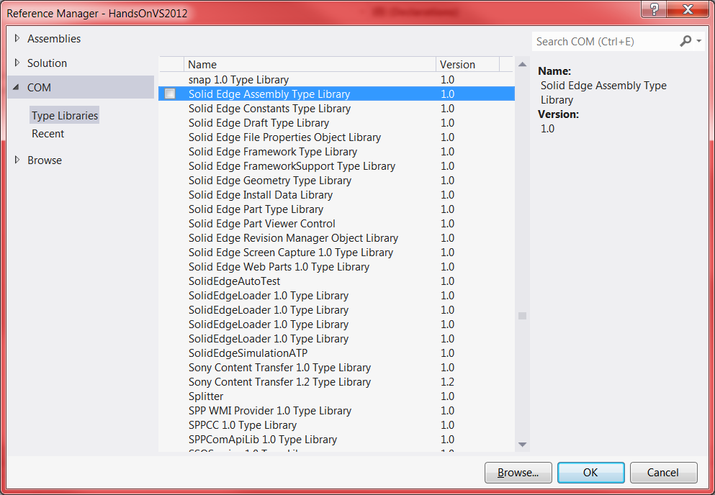
How to add references?
The Add Reference dialog window will appear. You will first need to click the COM tab. Scroll down until you get to the Solid Edge Type Libraries. Select the Solid Edge Framework Type Library as shown below.
When you add a COM reference in .NET, Visual Studio actually calls a Type Library Importer program that generates an "Interop Assembly" for your project to use. This also means that your executable will forever and always dependent upon the generated interop assembly. If you plan on deploying your application to users, you'll need to be sure to include any interop assemblies that you've generated for your project.

Slide 7
Solid Edge Assembly Type Library (assembly.tlb)
The SolidEdgeAssembly type library contains interfaces related to the 3-D Assembly environment.
The most important interface in this type library is the SolidEdgeAssembly.AssemblyDocument interface. This interface allows you to work directly with assembly document types in Solid Edge.

Slide 8
Solid Edge Constants Type Library (constant.tlb)
This type library is exclusively for global enumerations.
e.g: igRight, igUnitDistance, etc
Oleview.exe is a great way to view these enumerations and their values.
You should be aware that some of the enumerations defined in this type library are duplicated in other type libraries.

Slide 9
Solid Edge Drafts Type Library
The SolidEdgeDraft type library contains interfaces related to the 2-D Draft environment.
The most important interface in this type library is the SolidEdgeAssembly.DraftDocument interface. This interface allows you to work directly with draft document types in Solid Edge.

Slide 10
Solid Edge File Properties Object Library (PropAuto.dll)
This is a Lightweight API to get read/write access to a Solid Edge document’s file properties.
The SolidEdgeFileProperties API is used to read and write Solid Edge file properties outside of Solid Edge. This can be extremely useful when you need to quickly work with a large dataset of files. Solid Edge uses standard Microsoft Structured Storage API to store properties.
You can learn more about Microsoft’s Structured Storage API on MSDN at: http://msdn2.microsoft.com/en-us/library/aa380369(VS.80).aspx

Slide 11
Solid Edge Framework Type Library (framewrk.tlb)
The SolidEdgeFramework type library is the root type library. It has no dependencies on any other type library. At a minimum, you must reference it to interact with Solid Edge with strongly typed objects.
Most other core APIs have a dependency on this type library. One of the most important interfaces that you will work with is the SolidEdgeFramework.Application interface. You must get a reference to this object before you can do any automation in Solid Edge.
Typically, this comes in some form of GetObject() or CreateObject(). You can use the ProgID, “SolidEdge.Application” to get a reference to this object. Another important interface is the SolidEdgeFramework.SolidEdgeDocument interface.
You can use this interface to interrogate any Solid Edge document type. You will learn more about methods of obtaining these objects and how to use them in later chapters.

Slide 12
SolidEdgeFrameworkSupport Type Library (fwksupp.tlb)
The SolidEdgeFrameworkSupport type library contains interfaces that span all Solid Edge environments and are not environment specific.
All APIs for functionality common across all environments for 2D elements (lines, dimensons, boundaries,etc)

Slide 13
Solid Edge Geometry Type Library (geometry.tlb)
The SolidEdgeGeometry type library contains interfaces that relate to both 2D and 3D elements. ( body,face,curve,etc.)

Slide 14
Solid Edge Install Data Library (SEInstallData.dll)
This is a lightweight API to determine Solid Edge information such as path version, etc.
The SEInstallDataLib API is used to safely harvest installation information about Solid Edge from the Windows registry. It contains only one class, the SEInstallData class. This class has straight forward named methods to get installation information.
You can use the ProgID “SolidEdge.InstallData” to create an instance of the SEInstallData class.

Slide 15
Solid Edge Part Type Library (part.tlb)
The SolidEdgePart type library contains interfaces related to the following 3-D environments:
Part, SheetMetal, and Weldment. The most important interfaces in this type library are the SolidEdgePart.PartDocument, SolidEdgePart.SheetMetalDocument and SolidEdgePart.WeldmentDocument.
These interfaces allow you to work with a specific document type in SE.

Slide 16
Solid Edge Revision Manager Object Library (RevMgr.tlb)
The RevisionManager API can be used for several purposes.
Manage file properties
Manage link information
Integrate with Insight
You can use the ProgID 'RevisionManager.Application' to create an instance of the Application class.

Slide 17
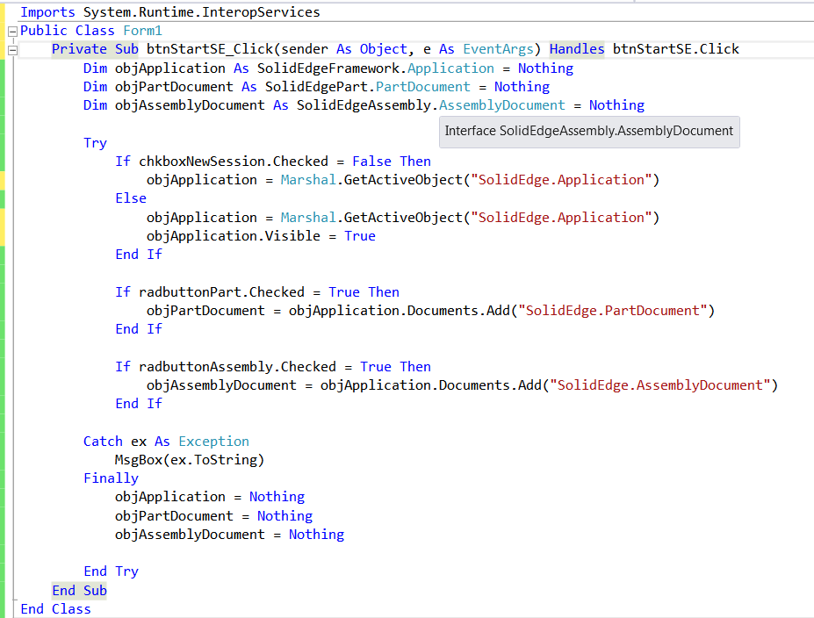
Create Your Code
You must have added the references in your project. Now add below code in your project to make it Live ☺

Slide 18
Contact
Greg Chasteen
Technical Account Manager
Siemens PLM Software
675 Discovery Drive, Suite 100
Huntsville, Al 35806
Office: (256) 705-2621
Cell:(256) 479-9055
E-mail:
chasteen.gregory@siemens.com

